Slide 1
The analysis of the quality of rights between genders using the Human Freedom Index
Ottillia Ni
April 25, 2019
Project Presentation Update (EM212: Applied Data Science)

Slide 2
Background
Annually updated report from the Cato Institute
Levels of freedom based upon various qualities on a scale of 0 to 10 (10 being the greatest amount)
“freedom plays an important role in human well-being, and they offer opportunities for further research into the complex ways in which freedom influences, and can be influenced by, political regimes, economic development, and the whole range of indicators of human well-being."

Slide 3
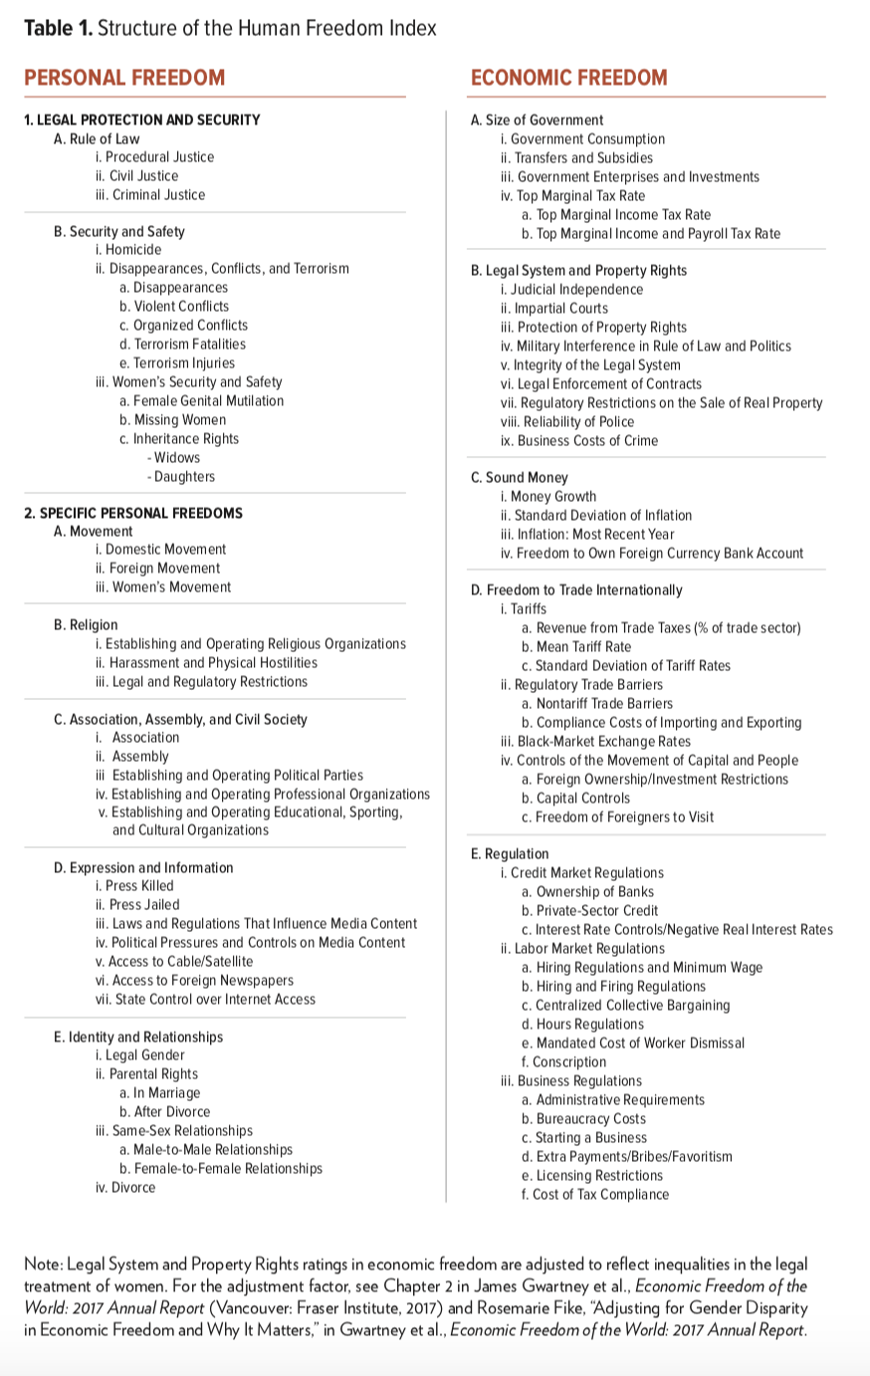
Reporting
Includes 162 countries for 2016
79 distinct indicators
Data collected since 2008
“The data come from credible external sources and, for the sake of objectivity, are not generated by us; the index is transparent on methodology and sources; and the report covers as large a number of countries over as long a time period as is possible given the data available.”
https://object.cato.org/sites/cato.org/files/human-freedom-index-files/human-freedom-index-2018-revised.pdf

Slide 4
Examples of how has this data been used
Mental Health, Happiness, Economics, Human Freedom (https://www.kaggle.com/rblcoder/mental-health-happiness-economics-human-freedom)
How has terrorism changed over the years? (https://www.kaggle.com/nikitagrec/how-has-terrorism-changed-over-years-geography)
World Wide Women’s Problems
(https://www.kaggle.com/akdagmelih/world-wide-women-s-problems-plotly-examples)

Slide 5
How does the female equality compare to male equality around the world on the basis of freedom?

Slide 6
Challenges
Types of plots that can answer my analysis question
What parameters the analysis is based upon
Understanding the translation of scoring
Too many variables and what each means
Needs specific filtering – only interest in variables that relate to gender

Slide 7
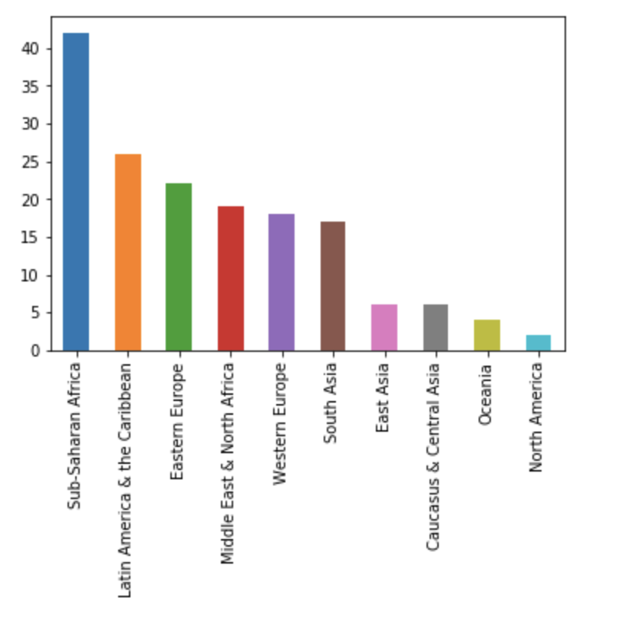
Number of countries in a given region 2016

Slide 8
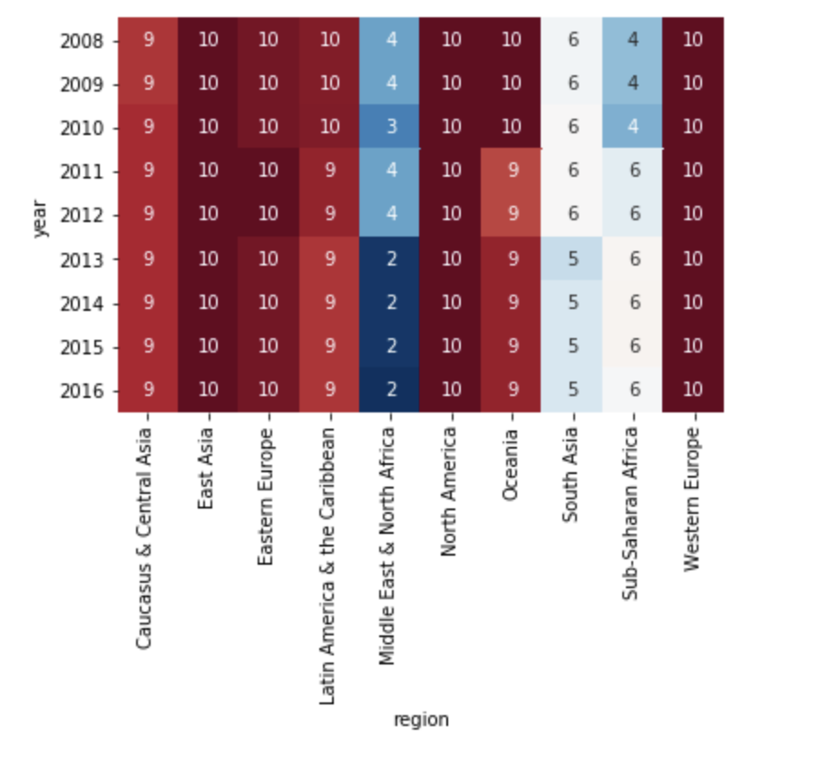
Ranking the balance of parental rights between male and female
"Parental rights refers to the extent to which women have equal rights based in law and custom regarding “legal guardianship of a child during a marriage and custody rights over a child after divorce."

Slide 9
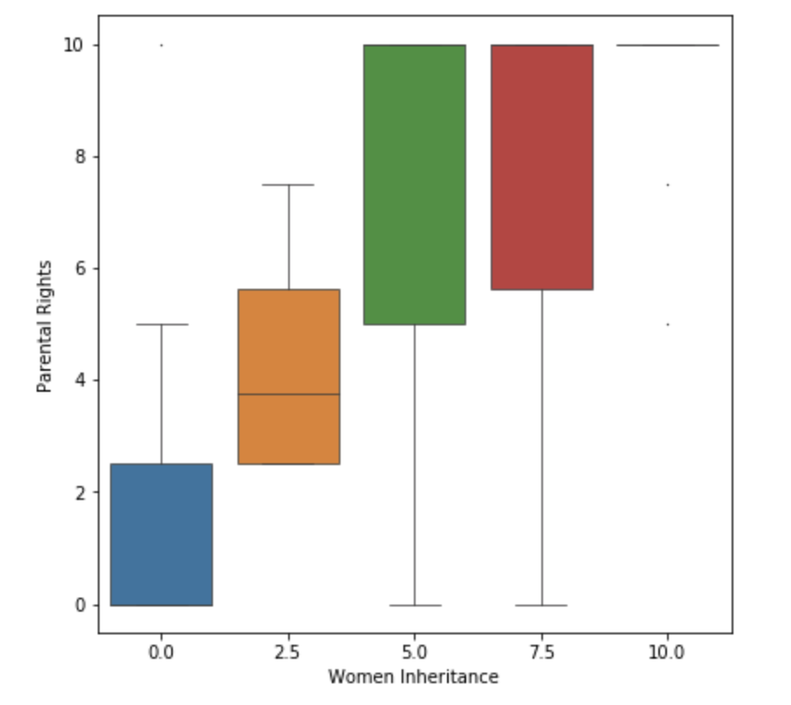
Box plot to show comparison of Women Inheritance Rights as compared to Parental Rights
Women Inheritance rights “measures whether the legal system favors males over widows and daughters in inheritance cases. Favoring males is an infringement on the liberty of parents and the daughters to whom they might otherwise choose to bequeath their assets.”

Slide 10
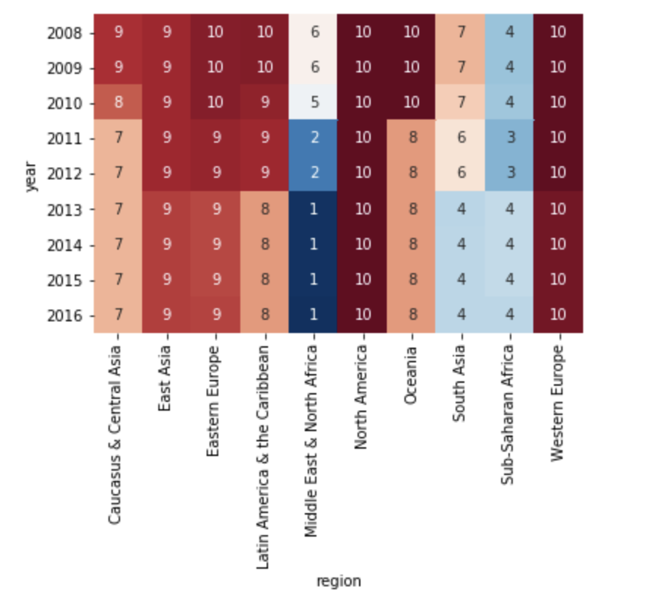
Ranking the balance of women inheritance rights between male and female

Slide 11
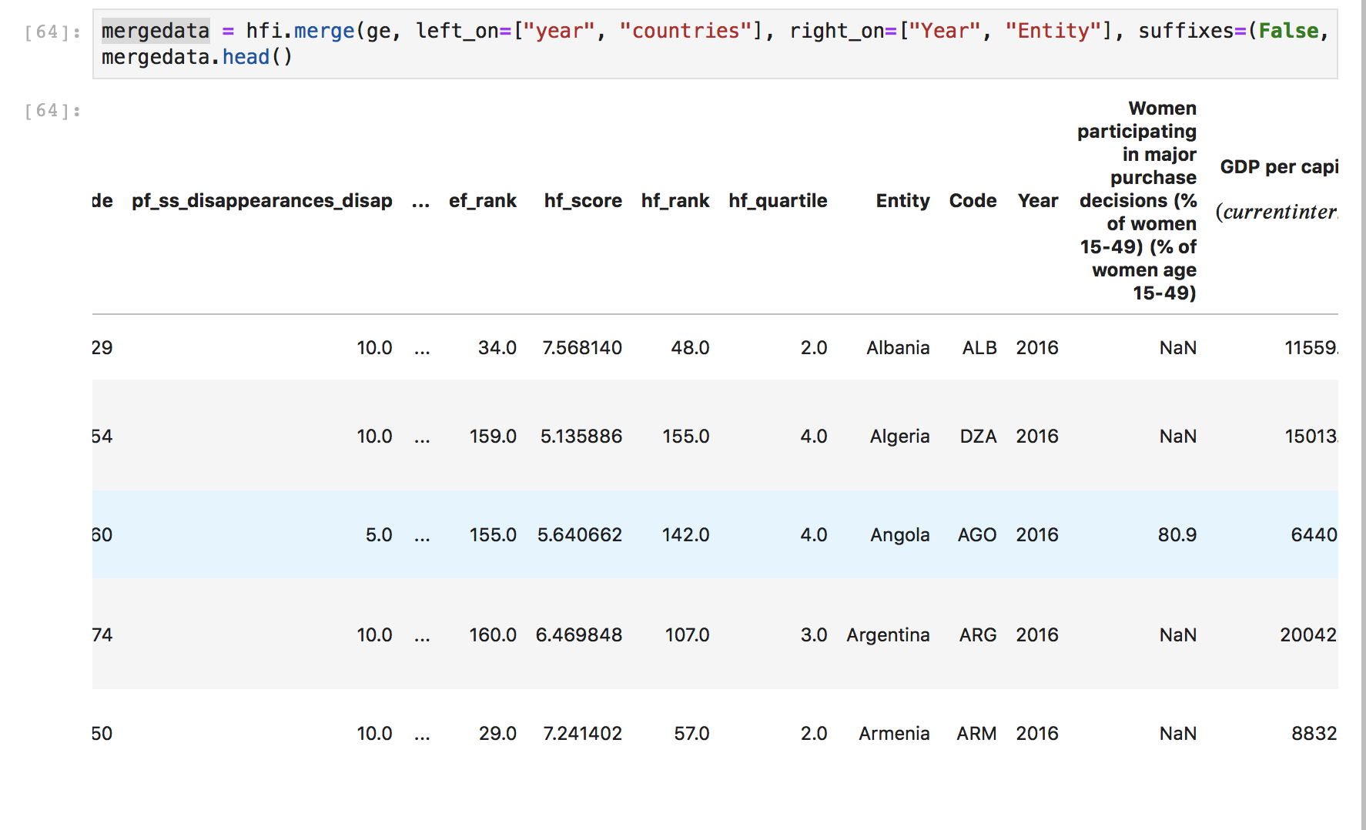
Merged Data
Participation of women in purchase decisions
“Percentage of currently married women aged 15-49 who say that they alone or jointly have a say in major household purchase decisions”

Slide 12
Next Steps
Run analysis with merged data
Determine which other variables are beneficial to my analysis and further clean through filtering
Add labels to make data easier to comprehend
Complete final report

Slide 13
Thank you! Feedback?

Slide 14
Things to consider:
Filter out data to only focus on variables I need
Any images I want to add to my report
Rename variables

